Slide 1
CPSC 583 Expert Systems Design Theory
Dr. Anand Panangadan
apanangadan@fullerton.edu

Slide 2
What we will cover today
Introductions
What are Expert Systems?
Where does this fit in the broader AI field?
Course Outline

Slide 3

A bit about myself
Associate Professor
Computer Science Department

Slide 4
Research interests
Applications of machine learning
Transportation, supportive housing
Social network analysis
Text mining
Sensor networks
Classification of time-series

Slide 5
A bit about yourself?
In the next 5 minutes:
Make groups of two
Introduce yourselves to each other
Learn your partner’s name
What they think of AI
Anything else they would like to share
Afterwards:
One group member introduces the other to the class

Slide 6
What is an Expert System?
Definition of Expert Systems
Rules as a knowledge representation technique
The main players in the development team
Structure of a rule-based expert system
Characteristics of an expert system
Following slides are based on “Artificial Intelligence: A Guide to Intelligent Systems” by M. Negnevitsky (Pearson education) and Christel Kempke

Slide 7
What is AI?
“The study and design of intelligent agents where an intelligent agent is a system that perceives its environment and takes actions that maximize its chances of success”
Russell and Norvig
“The science and engineering of making intelligent machines”
John McCarthy

Slide 8
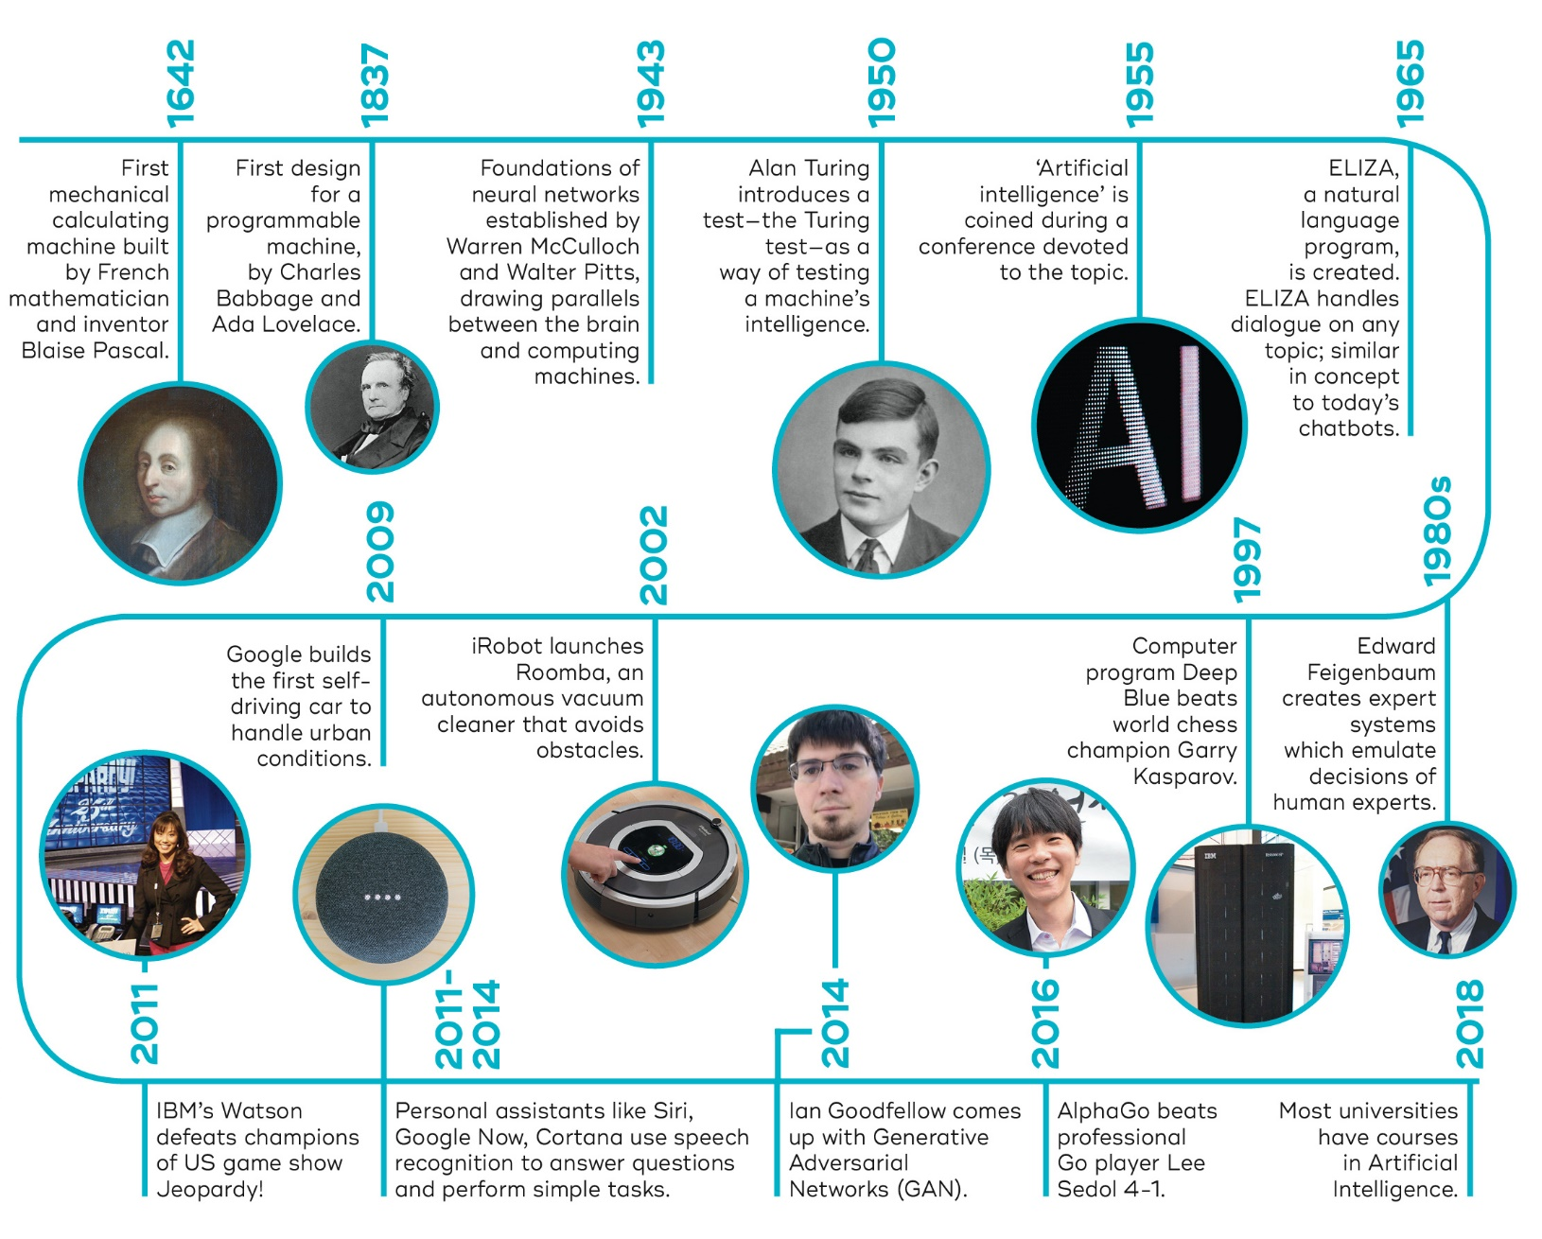
Boolean logic
First order logic
“AI winter”
330BC
1847
1879
1954
Aristotle:
Logic
Bayesian networks
https://qbi.uq.edu.au/files/40697/The-Brain-Intelligent-Machines-AI-timeline.jpg

Slide 9
History
1950 Claude Shannon’s “Programming a Computer for Playing Chess” is the first published article on developing a chess-playing computer program.
1950 Alan Turing publishes “Computing Machinery and Intelligence” in which he proposes “the imitation game” which will later become known as the “Turing Test.”
1956 the First AI Conference at Dartmouth: A program that simulates the machine; How can a computer be programmed to use a language; Neuron networks; Self-improvement through learning and reasoning
1970 The first anthropomorphic robot, the WABOT-1, is built at Waseda University in Japan. It consisted of a limb-control system, a vision system and a conversation system.
1972 MYCIN, an early expert system for identifying bacteria causing severe infections and recommending antibiotics, is developed at Stanford University.
1997 Deep Blue becomes the first computer chess-playing program to beat a reigning world chess champion.

Slide 10
A Brief History of AI: 1950s
Computers were thought of as an electronic brains
Term “Artificial Intelligence” coined by John McCarthy
Alan Turing defines intelligence as passing the Imitation Game (Turing Test)
AI research largely revolves around toy domains
Computers didn’t have enough power or memory to solve useful problems
Problems being researched include
games (e.g., checkers)
primitive machine translation
blocks world (planning and natural language understanding within the toy domain)
early neural networks: the perceptron
automated theorem proving and mathematics problem solving

Slide 11
The 1960s
AI attempts to move beyond toy domains
Syntactic knowledge alone does not work, domain knowledge required
Early machine translation could translate English to Russian (“the spirit is willing but the flesh is weak” becomes “the vodka is good but the meat is spoiled”)
Earliest expert system: Dendral
Perceptron research comes to a grinding halt when it is proved that a perceptron cannot learn the XOR operator
US sponsored research into AI targets specific areas
Weizenbaum creates Eliza to demonstrate the futility of AI

Slide 12
1970s
AI researchers address real-world problems through Expert Systems (knowledge-based)
Medical diagnosis
Speech recognition
Planning
Design
Uncertainty handling
Fuzzy logic
Certainty factors
Bayesian probabilities
AI begins to get noticed due to these successes
AI research increased
AI labs sprouting up everywhere
AI shells (tools) created
AI machines available for Lisp programming
Criticism: AI systems are too brittle, AI systems take too much time and effort to create, AI systems do not learn

Slide 13
1980s: AI Winter
Funding dries up leading to the AI Winter
Too many expectations were not met
Expert Systems took too long to develop, too much money to invest, the results did not pay off
Neural Networks
Get the computer to learn how to solve the problem
Multi-layered back-propagation networks got around the limitations of Perceptrons
Neural network research heavily funded because it promised to solve the problems that symbolic AI could not
By 1990, funding for neural network research was slowly disappearing as well
Neural networks had their own problems and largely could not solve a majority of the AI problems being investigated
Panic! How can AI continue without funding?

Slide 14
1990s: Artificial Life (Alife)
Start over! Let us not create intelligence, just create “life” and slowly build towards intelligence
Alife is the lower bound of AI
Alife includes
evolutionary learning techniques (genetic algorithms)
artificial neural networks for additional forms of learning
perception, motor control and adaptive systems
modeling the environment
Problems: genetic algorithms are useful in solving some optimization problems and some search-based problems, but not very useful for expert problems
Perceptual problems are among the most difficult being solved, very slow progress

Slide 15
2000s: Intelligent agents
AI researchers developing
Intelligent agents, multi-agent systems/collaboration, ontologies
Machine learning and data mining
Adaptive and perceptual systems
Robotics, path planning
Search engines, filtering, recommendation systems
Domain-specific approaches
Approaches
Knowledge-based
Ontologies
Probabilistic (HMM, Bayesian Nets)
Neural Networks

Slide 16
2010s: Deep Neural Networks
Dominance of deep layered NNs
GPU implementation
AlexNet wins ImageNet challenge 2012
More complex NN architectures
Recurrent NNs
Transformers

Slide 17
Today
Large Language Models
??

Slide 18
What is AI?
“AI system means a machine-based system that is designed to operate with varying levels of autonomy and that can, for explicit or implicit objectives, generate output such as predictions, recommendations, or decisions influencing physical or virtual environments”
Definition by the European Parliament as they work on the AI Act

Slide 19
What is Intelligence?
No precise definition
Some capabilities
learning
recognition, understanding
reasoning
imagination (or abstract thinking)
creativity
communication
planning
decision making
problem solving

Slide 20
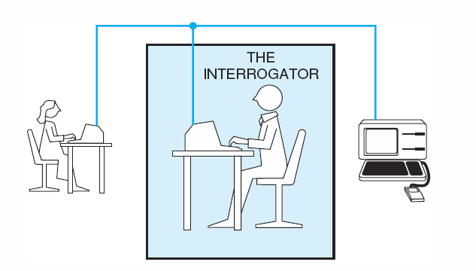
Turing Test
The Turing Test measures the performance of an intelligent machine against that of a human being through the imitation game.
Trying to determine which player – A or B – is a computer and which is a human
Can a system that passes a Turing Test be considered as intelligent as a human?
Notes:
Chatbot is an example, ELIZA in 1966

Slide 21
Importance and Criticisms of the Turing Test
Importance of Turing Test
Attempts to give an objective notion of intelligence by eliminating any bias in favor of living organisms.
Criticisms of Turing Test
Focuses on purely symbolic and problem-solving skills, not on perceptual skill.
A distraction to the important tasks such as developing general theories to explain the mechanisms of intelligence in human and machines to solve problems.
Only based on simulating human intelligence. Machine can do a lot better than human for many tasks.
Notes:
+Since the main focus is on simulating human intelligence at this time

Slide 22
The Chinese Room Problem
From John Searle, Philosopher, in an attempt to demonstrate that computers cannot be intelligent
Consider a room that consists of only:
You (who doesn’t speak Chinese), a book, and windows for moving a sheet of paper to and from the room to the outside
a Chinese speaking individual provides a question to you in writing
you look up a matching set of symbols in the book and write a response, also in Chinese
Question (Chinese)
Answer
(Chinese)
Storage
You
Book of Chinese Symbols

Slide 23
Searle’s argument
You were able to solve the problem of communicating with the person/user and thus you/the room passes the Turing Test
But do you understand Chinese?
since you do not speak Chinese, you did not understand the symbols in the question, the answer, or the storage
can we say that you actually used any intelligence?
By analogy, since you did not understand the symbols that you interacted with, neither does the computer understand the symbols that it interacts with (input, output, program code, data)
Searle defines two categories of AI:
strong AI – the pursuit of machine intelligence
weak AI – the pursuit of machines solving problems in an intelligent way

Slide 24
Rule-based approaches
ELIZA (1966)
A.L.I.C.E. (Artificial Linguistic Internet Computer Entity) (1995)

Slide 25
Class work
Spend 5-10 minutes chatting with these chatbots
ELIZA (1966)
A.L.I.C.E. (Artificial Linguistic Internet Computer Entity) (1995)
Report your observations

Slide 26
Classwork
On Google Drive
Link on Canvas
Go to today’s date and section
Editable and viewable by all
Create a new Google Document and name it with your groupmates’ names
E.g.: Garcia-Joshi
Write the names of your group members
Add your answers
Will not be graded
Can easily share with rest of class

Slide 27
Eliza Rules
(?* ?x) hello (?* ?y) →
(How do you do. Please state your problem.)
(?* ?x) I want (?* ?y) →
(What would it mean if you got ?y)
(Why do you want ?y)
(Suppose you got ?y soon)
(?* ?x) if (?* ?y) →
(Do you really think its likely that ?y)
(Do you wish that ?y)
(What do you think about ?y) (Really-- if ?y)
(?* ?x) no (?* ?y) → (Why not?)
(You are being a bit negative)
(Are you saying "NO" just to be negative?)
(?* ?x) I was (?* ?y) → (Were you really?)
(Perhaps I already knew you were ?y)
(Why do you tell me you were ?y now?)
(?* ?x) I feel (?* ?y) → (Do you often feel ?y ?)
(?* ?x) I felt (?* ?y) →
(What other feelings do you have?)
Also has a rule to swap ‘I’ and ‘my’ to ‘you’ and ‘your’

Slide 28
Eliza Pattern Syntax
pat ➔ var match any one expression to a variable
constant or to a constant (see below)
segment-pat match against a sequence
single-pat match against one expression
(pat . pat) match the first and the rest of a list
single-pat ➔
(?is var predicate) test predicate on one expression
(?or pat1 pat2 …) match on any of the patterns
(?and pat1 pat2 …) match on every of the expressions
(?not pat) match if expression does not match
segment-pat ➔
((?* var) …) match on zero or more expressions
((?+ var) …) match on one or more expressions
((?? var) …) match zero or one expression
((?if expr) …) test if expression is true
var ➔ ?chars variables of the form ?name
constant ➔ atom symbols, numbers, chars

Slide 29
ALICE Demo
Jerry: my name is jerry.
ALICE: Hey jerry.
Jerry: do you know Turing?
ALICE: A brilliant and tragic figure in the history of computer science.
Jerry: who else do you know?
ALICE: Hugh Loebner, Robby Garner, and Steven Spielberg
Jerry: which film do you like?
ALICE: My favorite movie is Teknolust. Have you seen it?
Jerry: no.
ALICE: I would recommend you check it out.
Jerry: what is it about?
ALICE: Science fiction.
Jerry: do you remember my name?
ALICE: Your name is jerry, seeker.
Notice unlike Eliza, ALICE has a memory, can handle references
“have you seen it? no. I would recommend it.”

Slide 30
Knowledge representation and reasoning
Knowledge representation
Representing knowledge in a format that can be used by computers
The sum of all knowledge in some format is called the Knowledge Base (KB)
Reasoning
Use stored knowledge to generate new information
Algorithms

Slide 31
Approaches to Knowledge Representation
Symbolic approaches
Formal logic-based
Propositional Logic
Predicate Logic
Description Logics
Production rules, Expert systems
Semantic Networks or knowledge graphs
Frames
Natural language representation:
Conceptual dependency theory

Slide 32
Approaches to Knowledge Representation
Non-symbolic approaches
Artificial neural networks
Feed-forward
Recurrent
…
Probabilistic graphical models
Bayesian networks
Markov networks
Natural language representation:
Word embeddings

Slide 33
What is an “Expert System” (XPS)?
Edward Feigenbaum
“An intelligent computer program that uses knowledge and inference procedures to solve problems that are difficult enough to require significant human expertise for their solutions.” [Giarratano & Riley 1998]
Also referred to as knowledge-based system

Slide 34
What is knowledge?
Knowledge is a theoretical or practical understanding of a subject or a domain. Knowledge is the sum of what is currently known. Those who possess knowledge are called experts.
A domain expert has deep knowledge (of both facts and rules) and strong practical experience in a particular domain. The area of the domain may be limited. An expert is a skilful person who can do things other people cannot.

Slide 35
Expert Systems
rely on internally represented knowledge to perform tasks
utilize reasoning methods to derive new knowledge
are usually restricted to a specific problem domain
some systems try to capture more general knowledge
General Problem Solver (Newell, Shaw, Simon)
Cyc (Lenat)

Slide 36
Main Components of an XPS
User
Knowledge Base
Expertise
User Interface
Facts / Observations
Knowledge / Rules
Inference Engine
Expertise
Developer

Slide 37
Main XPS Components
knowledge base
contains essential information about the problem domain
inference engine
mechanism to derive new knowledge from the knowledge base and the information provided by the user
user interface
interaction with end users
development and maintenance of the knowledge base

Slide 38
Early XPS Success Stories
DENDRAL (Feigenbaum, Lederberg, and Buchanan, 1965)
deduce the likely molecular structure of organic chemical compounds from known chemical analyses and mass spectrometry data
MYCIN (Buchanan and Shortliffe, 1972-1980)
diagnosis of infectious blood diseases and recommendation for use of antibiotics
“empty” MYCIN = EMYCIN = XPS shell
PROSPECTOR
analysis of geological data for minerals
discovered a mineral deposit worth $100 million
XCON/R1 (McDermott, 1978)
configuration of DEC VAX computer systems
2500 rules; processed 80,000 orders by 1986; saved DEC $25M a year

Slide 39
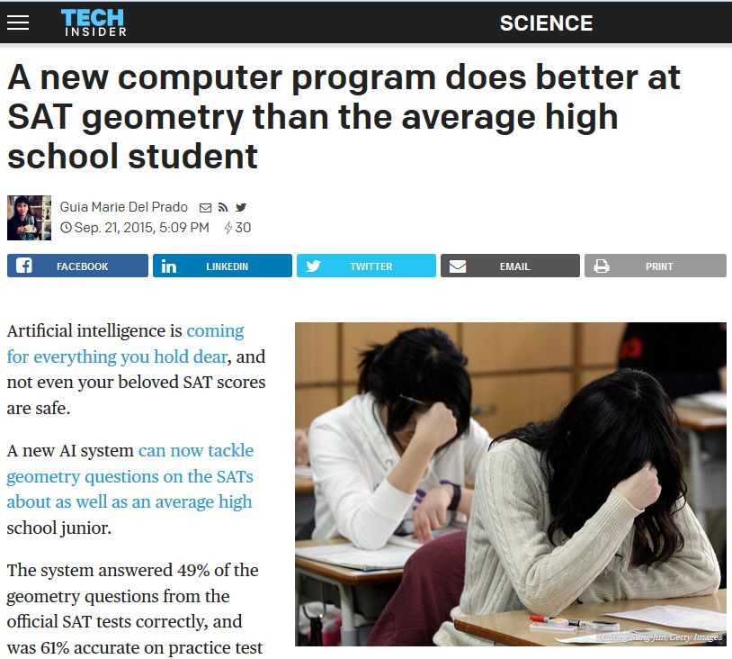
“AI system solves geometry questions as well as the average eleven year old”
Called GeoS, it uses a combination of computer vision to interpret diagrams, natural language processing to read and understand text and a geometric solver to achieve 49 percent accuracy on official SAT test questions
The Allen Institute approach has more in common with an earlier generation of artificial intelligence research that relied on logic and reasoning.
Moreover, the Allen Institute researchers said, machine-learning techniques have continued to fall short in areas where humans excel, such as problem solving.

Slide 40
Development of expert systems
strongly influenced by cognitive science
the way humans solve problems
and mathematics / logic
logic and inference

Slide 41
Rules for knowledge representation
A rule is an IF-THEN structure that relates given information, “facts”, in the IF part to some action in the THEN part.
Any rule consists of two parts: the IF part, called the antecedent (premise or condition) and
the THEN part called the consequent (conclusion or action).
A rule provides some description of how to solve a part of a problem.
Rules are relatively easy to create and understand.

Slide 42
Example Rules
IF … THEN Rules
Rule: Red_Light
IF the light is red
THEN stop
Rule: Green_Light
IF the light is green
THEN go
antecedent
(left-hand-side)
consequent
(right-hand-side)

Slide 43
Why rules?
Most experts are capable of expressing their knowledge in the form of rules for problem solving.
IF the ‘traffic light’ is green
THEN the action is go
IF the ‘traffic light’ is red
THEN the action is stop

Slide 44
Rules and Humans
rules can be used to formulate a theory of human information processing (Newell & Simon)
rules are stored in long-term memory
temporary knowledge is kept in short-term memory
(external) sensory input triggers the activation of rules
activated rules may trigger further activation (internal input; “thinking”)
a cognitive processor combines evidence from currently active rules
this model is the basis for the design of many rule-based systems (production systems)

Slide 45
Post Production Systems
Production rules were used by the logician Emil L. Post in the early 1940s in symbolic logic
Post’s theoretical result:
any system in mathematics or logic can be written as a production system
Basic principle of production rules
a set of rules governs the conversion of a set of strings into another set of strings
these rules are also known as rewrite rules
simple syntactic string manipulation
no understanding or interpretation is required

Slide 46
MYCIN Sample Rule
Human-Readable Format
IF the stain of the organism is gram negative
AND the morphology of the organism is rod
AND the aerobiocity of the organism is gram anaerobic
THEN there is strong evidence (0.8)
that the class of the organism is enterobacteriaceae
MYCIN Format
IF (AND (SAME CNTEXT GRAM GRAMNEG)
(SAME CNTEXT MORPH ROD)
(SAME CNTEXT AIR AEROBIC)
THEN (CONCLUDE CNTEXT CLASS ENTEROBACTERIACEAE TALLY .8)
[Durkin 94, p. 133]

Slide 47
Inference Engine Cycle
describes the execution of rules by the inference engine
“recognize-act cycle”
pattern matching
update the agenda (= conflict set)
add rules, whose antecedents are satisfied
remove rules with non-satisfied antecedents
conflict resolution
select the rule with the highest priority from the agenda
execution
perform the actions in the consequent part of the selected rule
remove the rule from the agenda
the cycle ends when no more rules are on the agenda, or when an explicit stop command is encountered
Notes:
Check on update phase – removing rules???

Slide 48
Inference engine cycles via a match-fire procedure

Slide 49
Class work
Consider the problem of deciding which course to take in a university degree program
This decision is typically made by a student (“the domain expert”)
How could this decision making be automated?
What are the facts?
What are the rules?

Slide 50
Main Components of an XPS
User
Knowledge Base
Expertise
User Interface
Facts / Observations
Knowledge / Rules
Inference Engine
Expertise
Developer

Slide 51
The main players in the development team
the domain expert
the knowledge engineer
the programmer
the end-user

Slide 52
Domain expert
The domain expert is a knowledgeable and skilled person capable of solving problems in a specific area or domain. This person has the greatest expertise in a given domain. This expertise is to be captured in the expert system. Therefore, the expert must be able to communicate his or her knowledge, be willing to participate in the expert system development and commit a substantial amount of time to the project.
The domain expert is the most important player in the expert system development team.

Slide 53
Knowledge engineer (You!)
The knowledge engineer is someone who is capable of designing, building and testing an expert system. He or she interviews the domain expert to find out how a particular problem is solved. The knowledge engineer establishes what reasoning methods the expert uses to handle facts and rules and decides how to represent them in the expert system. The knowledge engineer then chooses some development software or an expert system shell, or looks at programming languages for encoding the knowledge. And finally, the knowledge engineer is responsible for testing, revising and integrating the expert system into the workplace.

Slide 54
Programmer (You!)
The programmer is the person responsible for the actual programming, describing the domain knowledge in terms that a computer can understand. The programmer needs to have skills in symbolic programming in such AI languages as Prolog and also some experience in the application of different types of expert system shells. In addition, the programmer should know conventional programming languages.

Slide 55
End-user
The end-user is a person who uses the expert system after it is developed. The user must not only be confident in the expert system performance but also feel comfortable using it. Therefore, the design of the user interface of the expert system is also vital for the project’s success; the end-user’s contribution here can be crucial.

Slide 56
Comparison of expert systems with conventional systems and human experts

Slide 57
Comparison of expert systems with conventional systems and human experts (Continued)

Slide 58
Advantages of rule-based expert systems
Natural knowledge representation. An expert usually explains the problem-solving procedure with such expressions as this: “In such-and-such situation, I do so-and-so”. These expressions can be represented naturally as IF-THEN production rules.
Uniform structure. Production rules have the uniform IF-THEN structure. Each rule is an independent piece of knowledge. The syntax of production rules enables them to be self-documented.

Slide 59
Advantages of rule-based expert systems
Separation of knowledge from its processing.
The structure of a rule-based expert system provides an effective separation of the knowledge base from the inference engine. This makes it possible to develop different applications using the same expert system shell.
Dealing with incomplete and uncertain knowledge.
Most rule-based expert systems are capable of representing and reasoning with incomplete and uncertain knowledge.

Slide 60
Disadvantages of rule-based expert systems
Opaque relations between rules.
Although the individual production rules are relatively simple and self-documented, their logical interactions within the large set of rules may be opaque. Rule-based systems make it difficult to observe how individual rules serve the overall strategy.
Inefficient search strategy.
The inference engine applies an exhaustive search through all the production rules during each cycle. Expert systems with a large set of rules (over 100 rules) can be slow, and thus large rule-based systems can be unsuitable for real-time applications.

Slide 61
Disadvantages of rule-based expert systems
Inability to learn
In general, rule-based expert systems do not have an ability to learn from the experience. Unlike a human expert, who knows when to “break the rules”, an expert system cannot automatically modify its knowledge base, or adjust existing rules or add new ones. The knowledge engineer is still responsible for revising and maintaining the system.

Slide 62
Disadvantages of rule-based expert systems
limited knowledge
“shallow” knowledge
no “deep” understanding of the concepts and their relationships
no “common-sense” knowledge
no knowledge from possibly relevant related domains
“closed world”
the XPS knows only what it has been explicitly “told”
it doesn’t know what it doesn’t know
mechanical reasoning
may not have or select the most appropriate method for a particular problem
some “easy” problems are computationally very expensive
lack of trust
users may not want to leave critical decisions to machines

Slide 63
When (Not) to Use an Expert System
Expert systems are not suitable for all types of domains and tasks
They are not useful or preferable, when …
efficient conventional algorithms are known
the main challenge is computation, not knowledge
knowledge cannot be captured efficiently or used effectively

Slide 64
Syllabus
See Canvas page

